Slide 1
Rowan class year 3
2026-2027
Mrs rossiter

Slide 2
Who is in our team?
Mrs Rossiter
Mrs Thomas

Slide 3


Slide 4

Our school rules

Slide 5
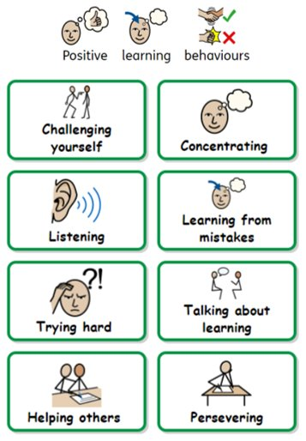


Slide 6
What does your child need at school?
A named water bottle
A named coat – everyday in the Autumn, Winter and Spring at least please!
Named uniform
A snack

Slide 7
What does your child need to wear to school?
The Official School Uniform:
Grey or black trousers
Grey or black skirt
Grey pinafore
In the summer girls can wear red/ white gingham check dresses and boys can wear grey shorts.
Red cardigan or sweatshirt
White polo shirt
Black or grey socks. Black, grey or red tights.
Black sensible school shoes [ not trainers]
Children should not wear any jewellery apart from one stud earring per ear and a watch. They will need to remove these for PE.
Hair bands should be simple and in school colours.
Long hair shoulder length and beyond, must be tied back.
They must have a coat in school at all times.
P.E Kits
Black shorts or jogging bottoms
A coloured T shirt depicting their colour team.
Plimsolls [ daps]
PE bags
It is essential that all your child's clothing is named.

Slide 8
What does your child NOT NEED AT SCHOOL?
Pencil cases
Toys

Slide 9
Uniform expectations

Slide 10

Lunchtime
If your child has a packed lunch, we will not be allowing them to dispose of their rubbish in school. This is to support parents in seeing what they have and haven’t eaten.
Allergies

Slide 11
Pick up at the end of the day
If you are sending an alternative adult to collect your child at the end of the day, it is helpful if you let me know
They must have collection permission

Slide 12
How can you help your child?
- Read daily - Practise number facts - Ensure good attendance - Encourage independence - Talk about learning – when they are ready!

Slide 13
Important dates
28th September – Harvest festival (donations please)
28th September – MTC Workshop
6th October – Schools photos
7th October – Flu vaccinations
20th October and 22nd October – Parents evenings

Slide 14
CONTACTING ME
At drop off/pick up
Phone call after school
Email the office – they forward them to me
Don’t leave it until parents evening – 10 minute slots!

Slide 15
Any questions?

