Slide 1

MTC Workshop
2026 - 2027

Slide 2
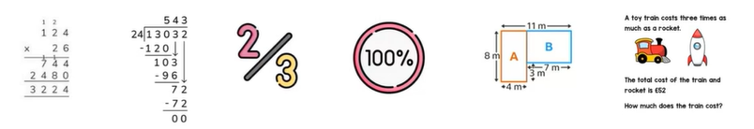
Multiplication Tables Check (MTC)
National assessment for all Year 4 children
National goal for children to have automatic recall their times tables facts to 12 x 12 by the end of Year 4
Times tables underpin many other mathematical concepts
Roughly 30% of KS2 SATs questions are supported by times tables knowledge

Slide 3
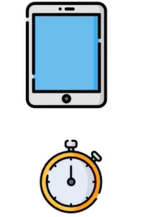
How the MTC works
Digital assessment – normally we use iPads
3 warm up questions followed by 25 questions
Each test is unique, but the standard is the same.
6 seconds to answer with a 3 second pause
Encourage the children not to press enter
Children will be in small groups
Access arrangements – increase font size, audio version, audible time alerts, pause/next button (breathing space)

Slide 4

When is the MTC?
2 Week Window – 7th June 2027
Week 1 – Complete the MTC
Week 2 – Administer the check for any children absent

Slide 5
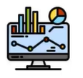
What happens after the MTC?
There is no pass mark
The check is part of a learning process
It is only one measure of your child’s proficiency
Results are used to help the school identify areas of development
Results help identify children who need extra support with their tables moving forward
Results will be shared with you at their parents evening

Slide 6
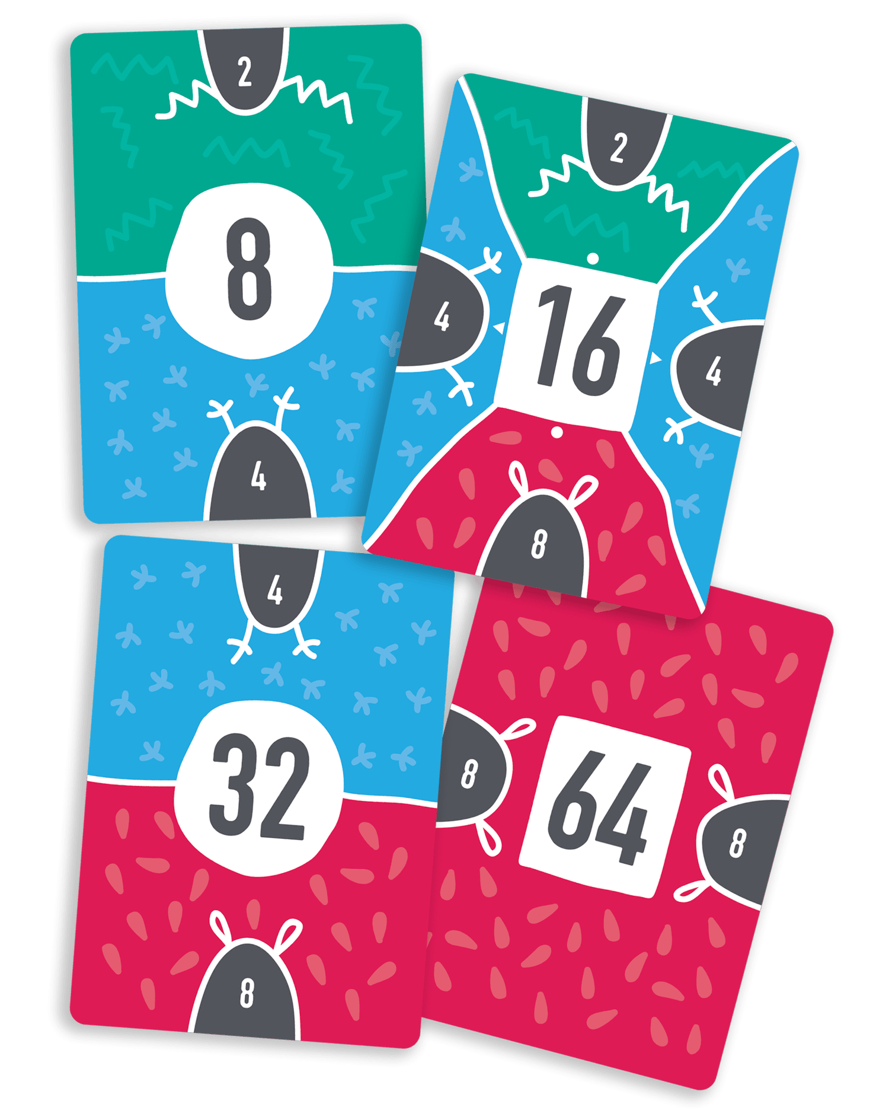
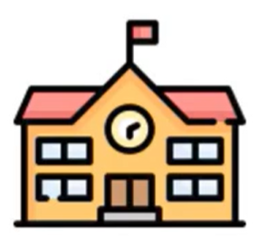
How do we prepare at school?
Daily practice of step counting
Discreet teaching to recognise the patterns
Songs
FunKey Maths cards - Year 2 - Step Counting & Recall (2s) – YouTube
Games
TTRockStars – its algorithm focuses on the child’s individual progress
  Soundcheck
  Garage
  Tournaments

Slide 7
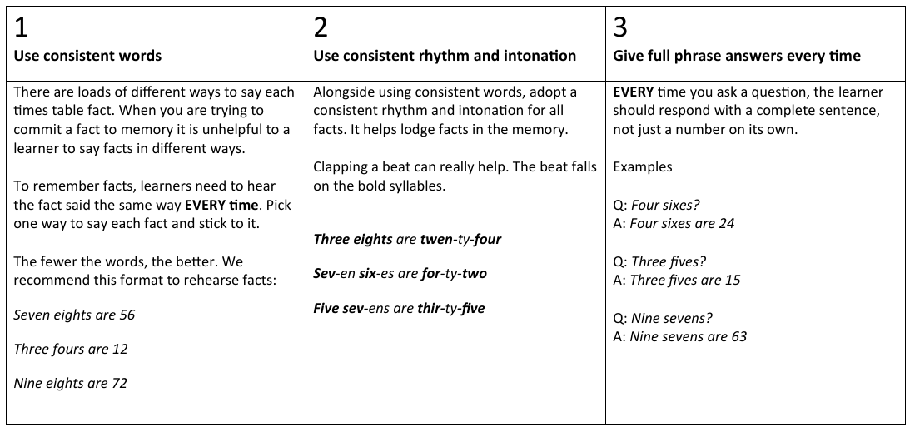
FunKey Maths Golden Rules
Year 2 - Step Counting & Recall (2s) – YouTube

Slide 8
All Multiplication Facts
0 x 0 = 0 | 0 x 1 = 0 | 0 x 2 = 0 | 0 x 3 = 0 | 0 x 4 = 0 | 0 x 5 = 0 | 0 x 6 = 0 | 0 x 7 = 0 | 0 x 8 = 0 | 0 x 9 = 0 | 0 x 10 = 0 | 0 x 11 = 0 | 0 x 12 = 0
1 x 0 = 0 | 1 x 1 = 1 | 1 x 2 = 2 | 1 x 3 = 3 | 1 x 4 = 4 | 1 x 5 = 5 | 1 x 6 = 6 | 1 x 7 = 7 | 1 x 8 = 8 | 1 x 9 = 9 | 1 x 10 = 10 | 1 x 11 = 11 | 1 x 12 = 12
2 x 0 = 0 | 2 x 1 = 2 | 2 x 2 = 4 | 2 x 3 = 6 | 2 x 4 = 8 | 2 x 5 = 10 | 2 x 6 = 12 | 2 x 7 = 14 | 2 x 8 = 16 | 2 x 9 = 18 | 2 x 10 = 20 | 2 x 11 = 22 | 2 x 12 = 24
3 x 0 = 0 | 3 x 1 = 3 | 3 x 2 = 6 | 3 x 3 = 9 | 3 x 4 = 12 | 3 x 5 = 15 | 3 x 6 = 18 | 3 x 7 = 21 | 3 x 8 = 24 | 3 x 9 = 27 | 3 x 10 = 30 | 3 x 11 = 33 | 3 x 12 = 36
4 x 0 = 0 | 4 x 1 = 4 | 4 x 2 = 8 | 4 x 3 = 12 | 4 x 4 = 16 | 4 x 5 = 20 | 4 x 6 = 24 | 4 x 7 = 28 | 4 x 8 = 32 | 4 x 9 =36 | 4 x 10 = 40 | 4 x 11 = 44 | 4 x 12 = 48
5 x 0 = 0 | 5 x 1 = 5 | 5 x 2 = 10 | 5 x 3 = 15 | 5 x 4 = 20 | 5 x 5 = 25 | 5 x 6 = 30 | 5 x 7 = 35 | 5 x 8 = 40 | 5 x 9 = 45 | 5 x 10 = 50 | 5 x 11 = 55 | 5 x 12 = 60
6 x 0 = 0 | 6 x 1 = 6 | 6 x 2 = 12 | 6 x 3 = 18 | 6 x 4 = 24 | 6 x 5 = 30 | 6 x 6 = 36 | 6 x 7 = 42 | 6 x 8 = 48 | 6 x 9 = 54 | 6 x 10 = 60 | 6 x 11 = 66 | 6 x 12 = 72
7 x 0 = 0 | 7 x 1 = 7 | 7 x 2 = 14 | 7 x 3 = 21 | 7 x 4 = 28 | 7 x 5 = 35 | 7 x 6 = 42 | 7 x 7 = 49 | 7 x 8 = 56 | 7 x 9 = 63 | 7 x 10 = 70 | 7 x 11 = 77 | 7 x 12 = 84
8 x 0 = 0 | 8 x 1 = 8 | 8 x 2 = 16 | 8 x 3 = 24 | 8 x 4 = 32 | 8 x 5 = 40 | 8 x 6 = 48 | 8 x 7 = 56 | 8 x 8 = 64 | 8 x 9 = 72 | 8 x 10 = 80 | 8 x 11 = 88 | 8 x 12 = 96
9 x 0 = 0 | 9 x 1 = 9 | 9 x 2 = 18 | 9 x 3 = 27 | 9 x 4 = 36 | 9 x 5 = 45 | 9 x 6 = 54 | 9 x 7 = 63 | 9 x 8 = 72 | 9 x 9 = 81 | 9 x 10 = 90 | 9 x 11 = 99 | 9 x 12 = 108
10 x 0 = 0 | 10 x 1 = 10 | 10 x 2 = 20 | 10 x 3 = 30 | 10 x 4 = 40 | 10 x 5 = 50 | 10 x 6 = 60 | 10 x 7 = 70 | 10 x 8 = 80 | 10 x 9 = 90 | 10 x 10 = 100 | 10 x 11 = 110 | 10 x 12 = 120
11 x 0 = 0 | 11 x 1 = 11 | 11 x 2 = 22 | 11 x 3 = 33 | 11 x 4 = 44 | 11 x 5 = 55 | 11 x 6 = 66 | 11 x 7 = 77 | 11 x 8 = 88 | 11 x 9 = 99 | 11 x 10 = 110 | 11 x 11 = 121 | 11 x 12 = 132
12 x 0 = 0 | 12 x 1 = 12 | 12 x 2 = 24 | 12 x 3 = 36 | 12 x 4 = 48 | 12 x 5 = 60 | 12 x 6 = 72 | 12 x 7 = 84 | 12 x 8 = 96 | 12 x 9 = 108 | 12 x 10 = 120 | 12 x 11 = 132 | 12 x 12 = 144
 | Too easy! You don’t need to learn these. |  | The basics |  | The core 38 multiplication facts |  | Repeats of the other facts

Slide 9
38 Core Multiplication Facts
3 x 3 = 9 | 3 x 4 = 12 | 3 x 5 = 15 | 3 x 6 = 18 | 3 x 7 = 21 | 3 x 8 = 24 | 3 x 9 = 27 |  |  | 3 x 12 = 36
 | 4 x 4 = 16 | 4 x 5 = 20 | 4 x 6 = 24 | 4 x 7 = 28 | 4 x 8 = 32 | 4 x 9 =36 |  |  | 4 x 12 = 48
 |  | 5 x 5 = 25 | 5 x 6 = 30 | 5 x 7 = 35 | 5 x 8 = 40 | 5 x 9 = 45 |  |  | 5 x 12 = 60
 |  |  | 6 x 6 = 36 | 6 x 7 = 42 | 6 x 8 = 48 | 6 x 9 = 54 |  |  | 6 x 12 = 72
 |  |  |  | 7 x 7 = 49 | 7 x 8 = 56 | 7 x 9 = 63 |  |  | 7 x 12 = 84
 |  |  |  |  | 8 x 8 = 64 | 8 x 9 = 72 |  |  | 8 x 12 = 96
 |  |  |  |  |  | 9 x 9 = 81 |  |  | 9 x 12 = 108
 |  |  |  |  |  |  |  | 11 x 11 = 121 | 11 x 12 = 132
 |  |  |  |  |  |  |  |  | 12 x 12 = 144

Slide 10
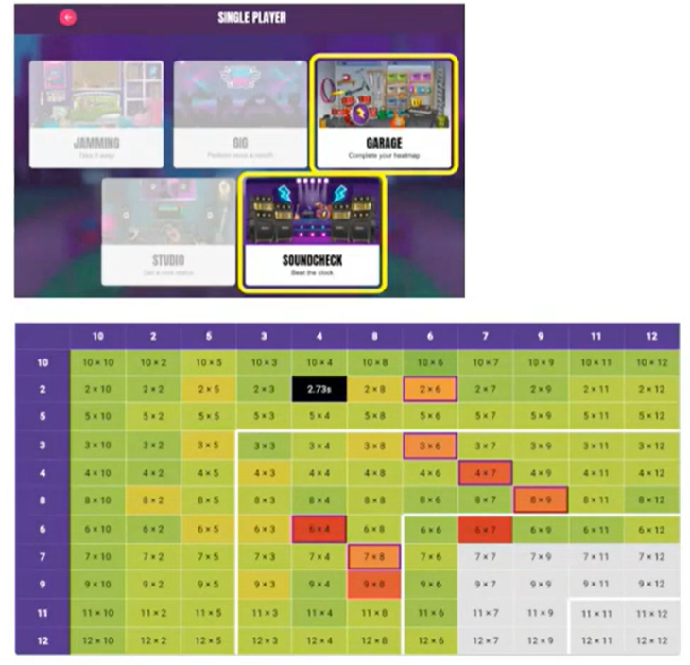
How can children prepare at home?
Effort over perfection
Keep building their confidence
Celebrate the small wins
Make use o their heatmaps
Complete weekly TTRockStars homework
Short regular practise

Slide 11
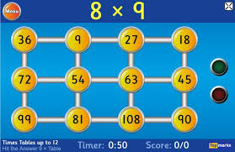
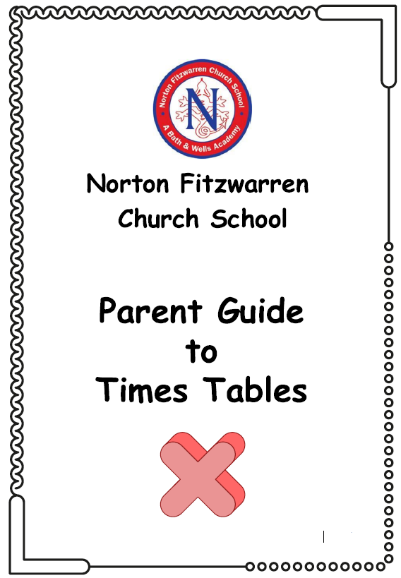
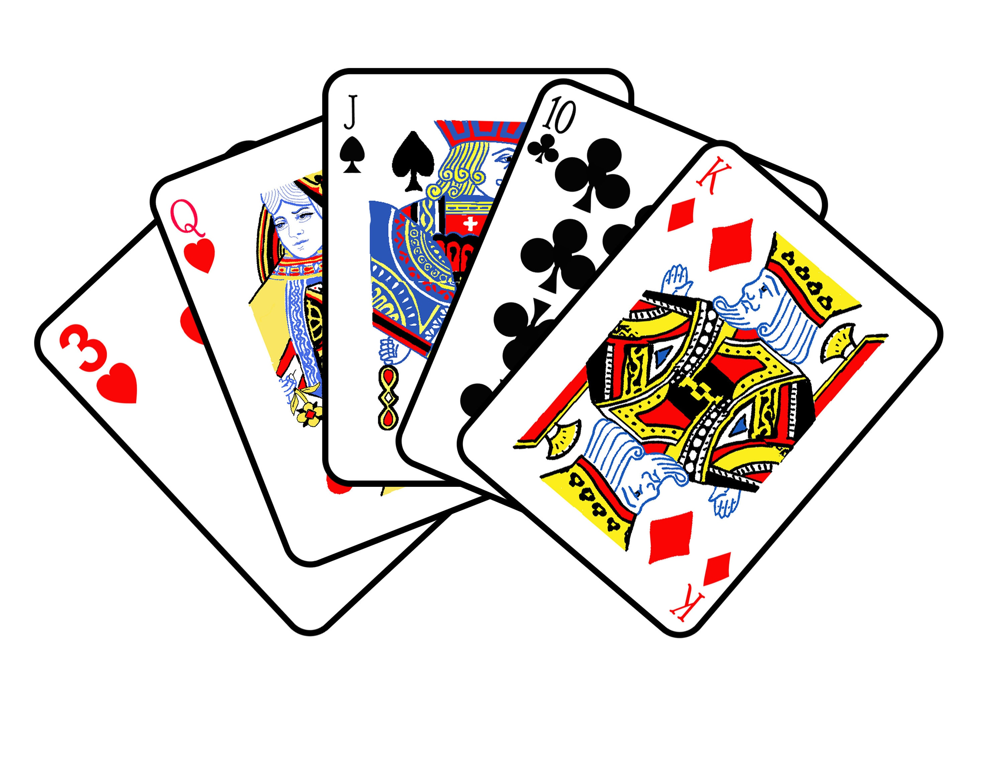
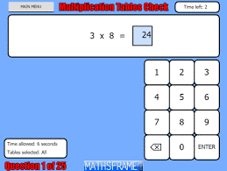

How can they practise?
Check out this guide on our website which includes lots of suggestions of card games, the links to the songs we use and other resources.
TTRockStars
Maths Frame’s MTC Simulator

Slide 12
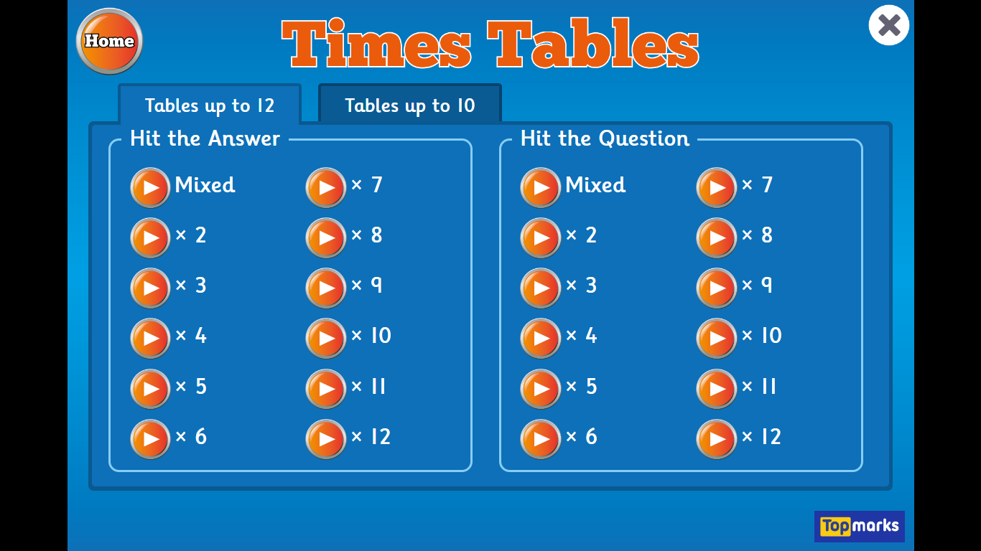
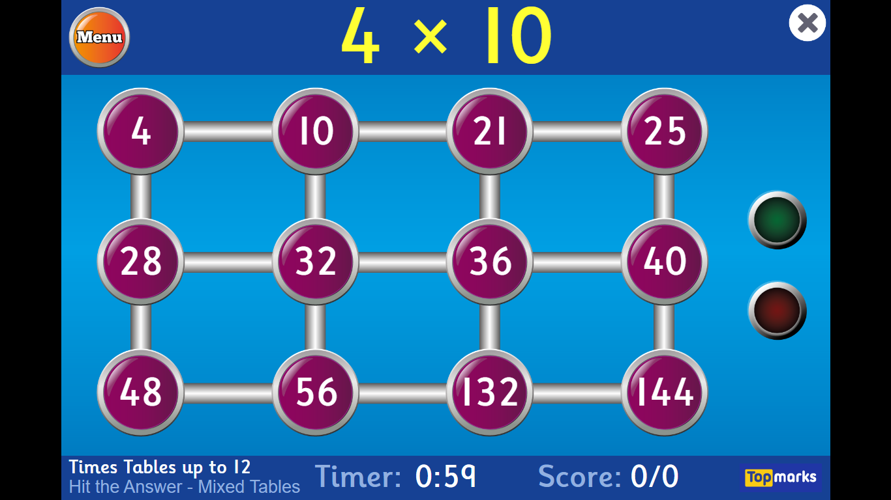
Hit the Button
Hit the Button - Quick fire maths practise for 6-11 year olds (topmarks.co.uk)

Slide 13


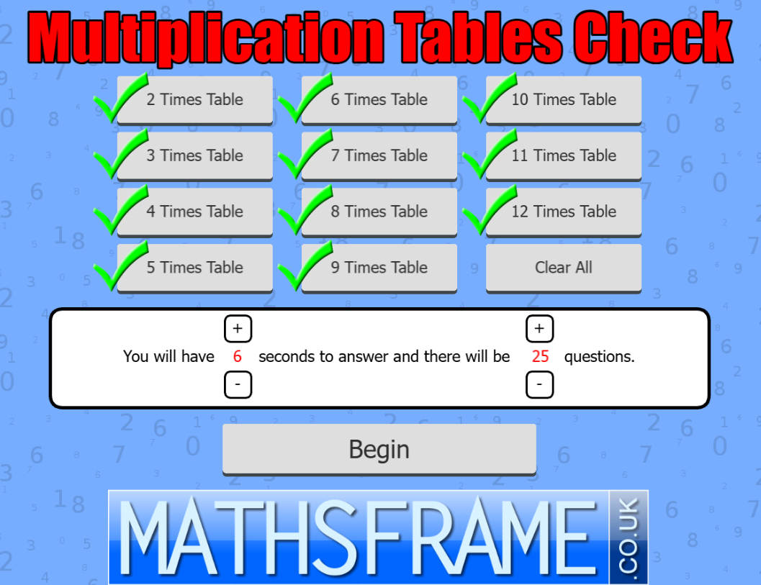
Maths Frame – MTC Simulator
Multiplication Tables Check - Mathsframe

Slide 14

Any questions?

