Slide 1
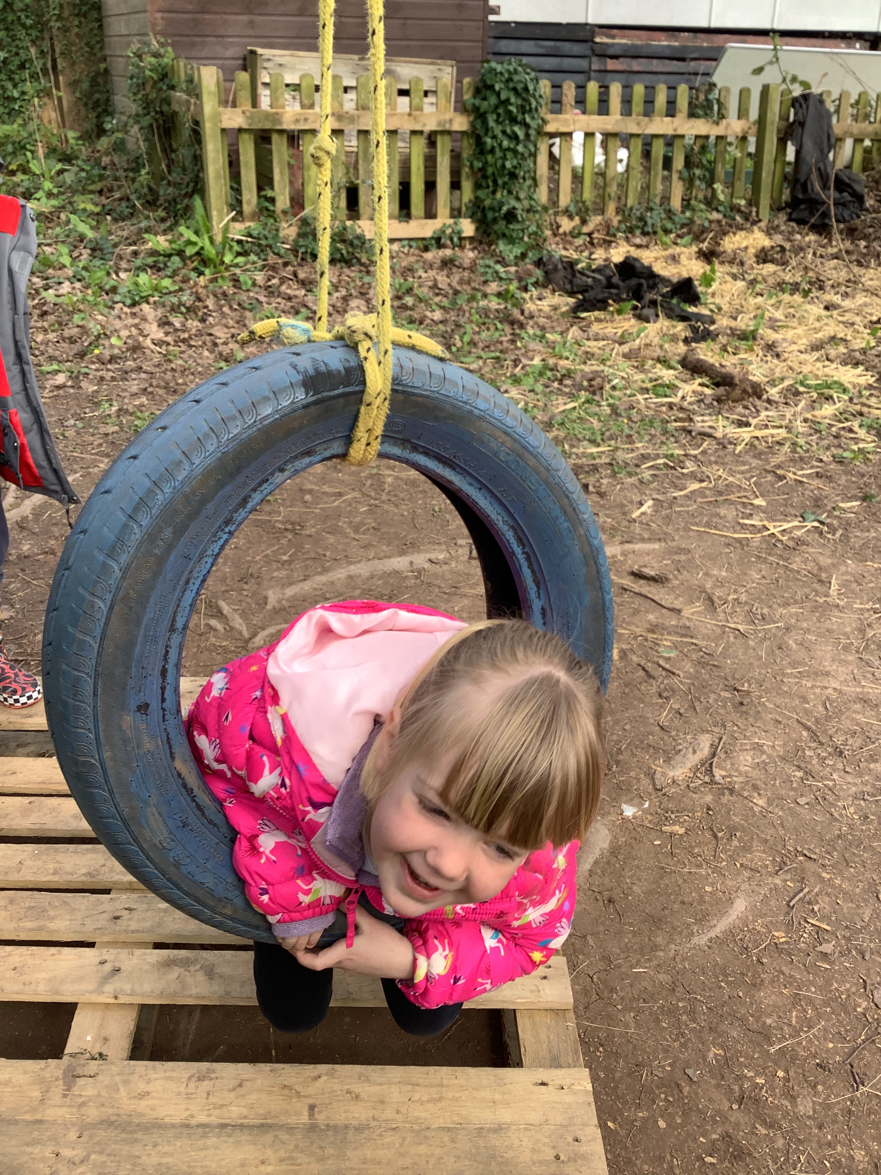
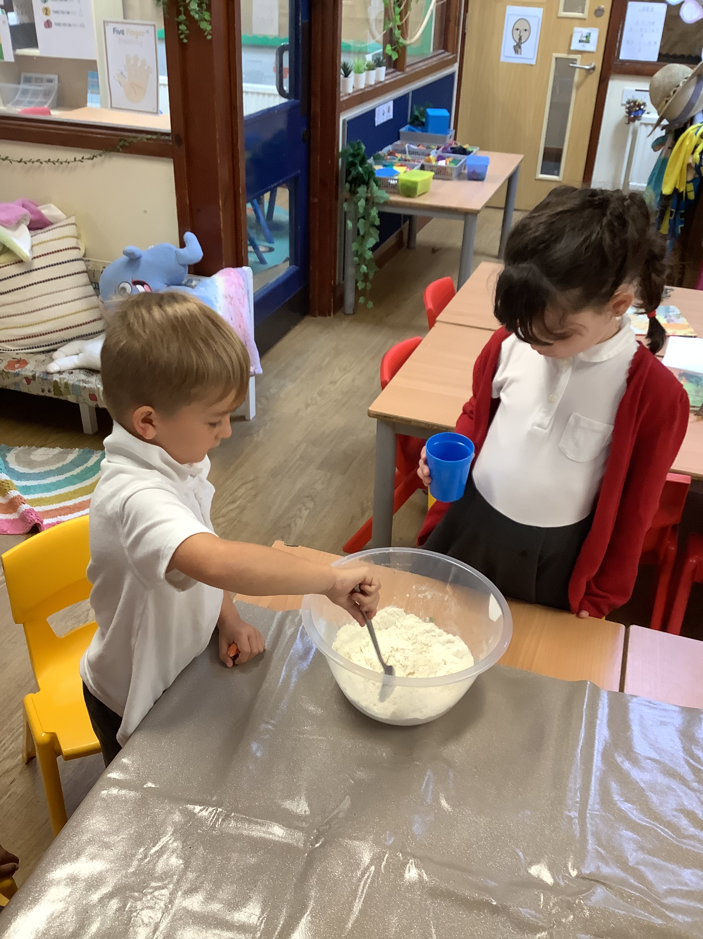
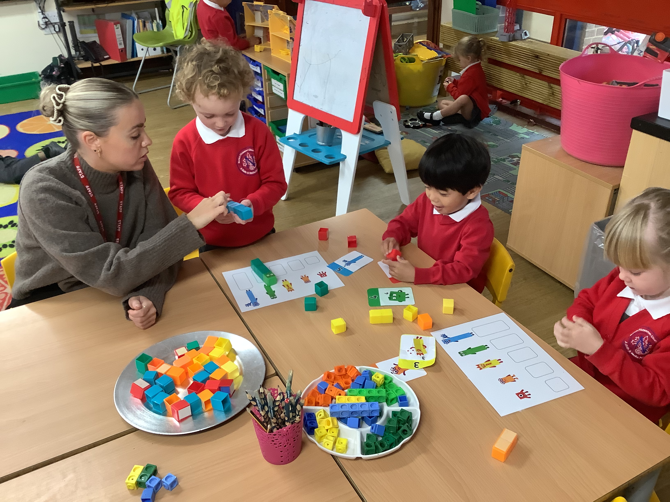
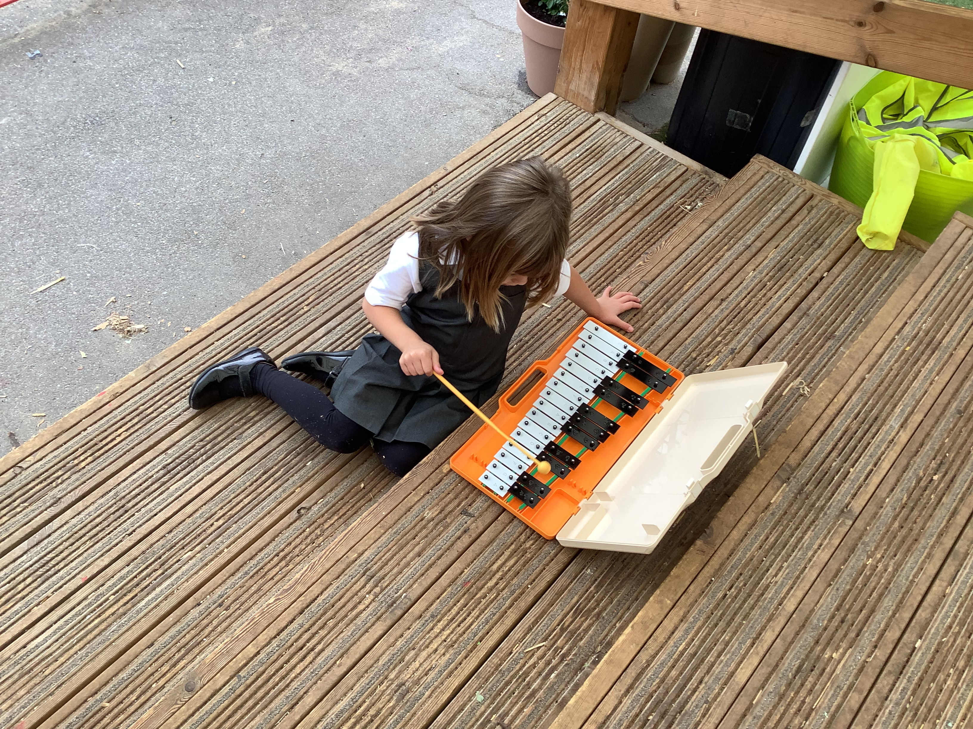
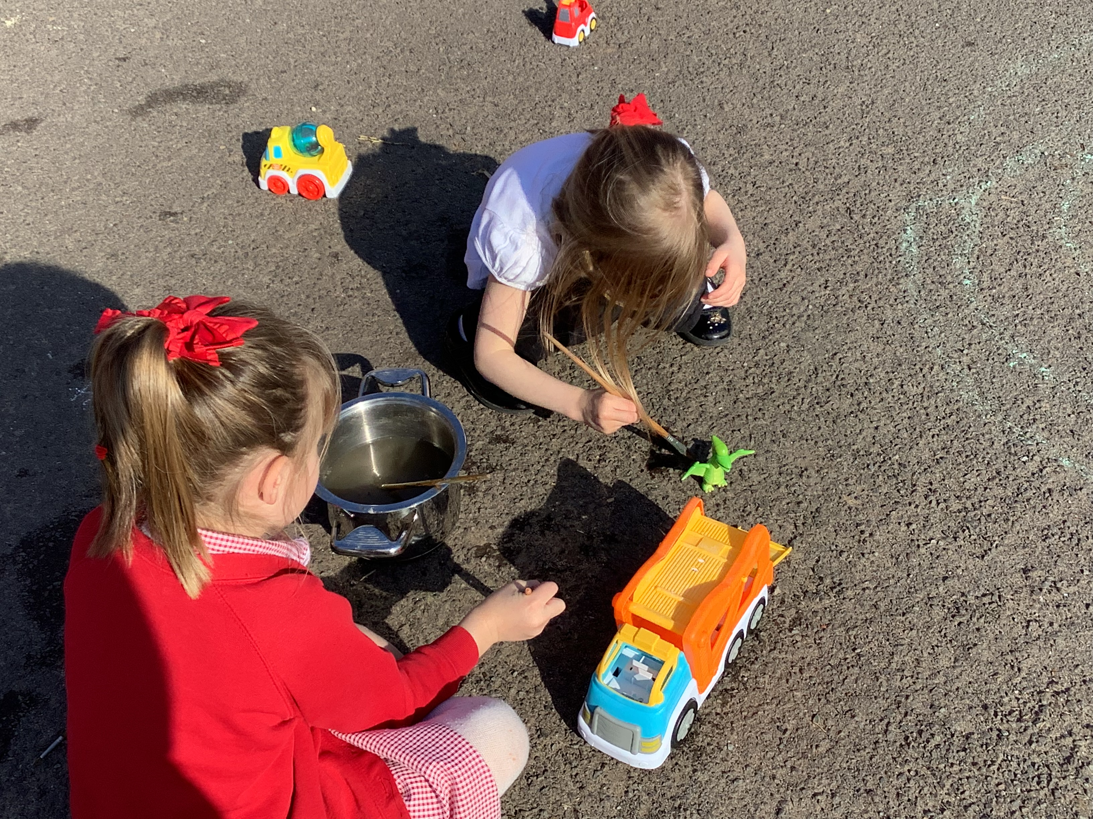
Welcome to Ash class!

Slide 2
Reception/Year 1
Miss Blackmore – Class Teacher
Mrs Drew – Teaching Assistant
Mrs Parker- PPA cover

Slide 3







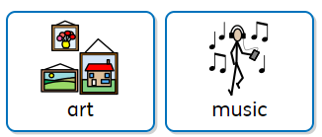
What we will be learning…..
Everyday....
Some days....

Slide 4



PE day- Friday
Book change day- Wednesday

Slide 5
Learning at home......
Read as much as possible – exploring vocabulary/characters/settings/new worlds/story maps
Phonics – videos for support/consolidation/blending books
Letter formation/name writing/everyday writing – lists, birthday cards, postcards
Play games – Dice games/Top trumps/Cards/Dominoes
Sharing our text maps & retelling stories

Slide 6

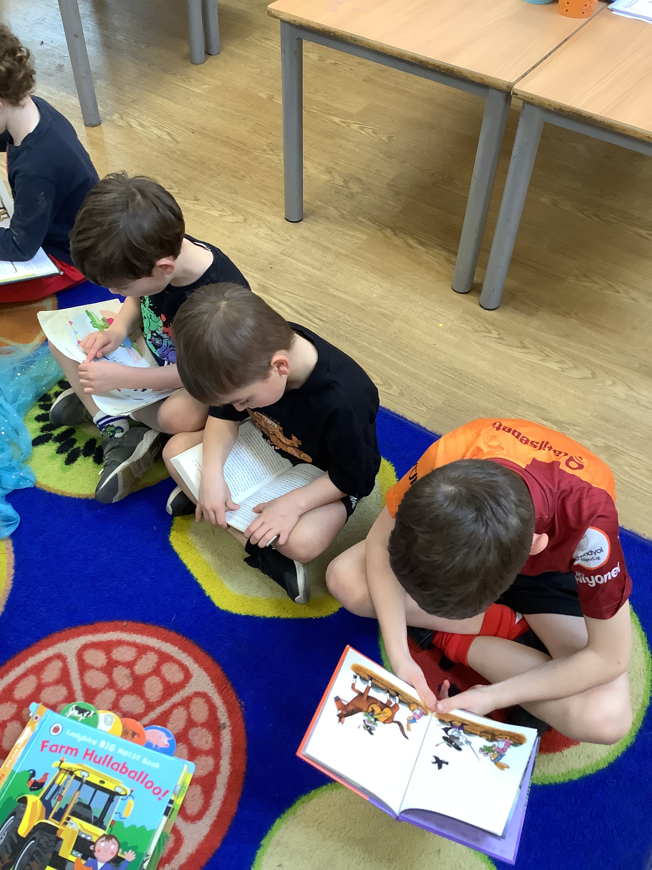
Phonics at home
Parent guide to Read Write Inc. Phonics - Oxford Owl
QR codes- Fred games

Slide 7
Communication
Available for quick messages before school on the gate
By appointment for longer meetings after school via the school office
Telephone/email – the office pass us any messages and we will endeavour to ring back as soon as we are free
Tapestry – weekly updates of learning of EYFS – website for everyone.
General school newsletters – monthly
Curriculum newsletters – half termly

